Slide 1
Analysis of Algorithms
Maximum weight matching
Uri Zwick
May 2014 Modified: January 1, 2018 Modified: November 30 – December 29, 2021
TexPoint fonts used in EMF.
Read the TexPoint manual before you delete this box.: AAAAA

Slide 2
Maximum Weight Matching
Find a matching whose total weight is maximal.
3
22
6
15
8
4
8
18
1
5
25
7
2
Maximum weight matching

Slide 3
Maximum Weight Matching
Find a matching whose total weight is maximal.
3
22
6
15
8
4
8
18
1
5
25
7
2
An augmenting path that increases the size of the matching, but not the total weight of the matching.

Slide 4
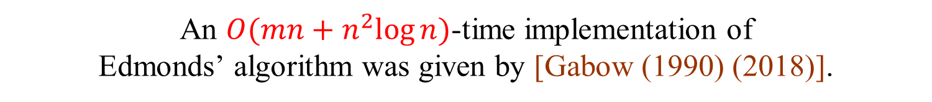

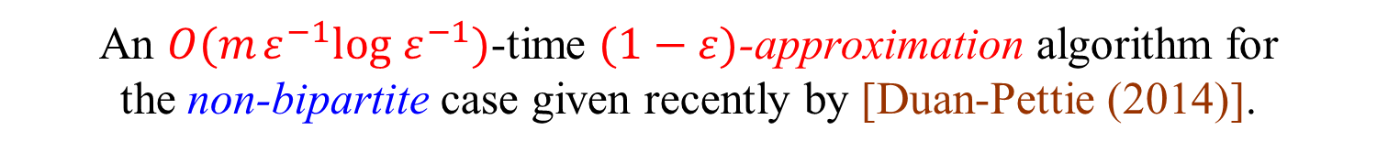
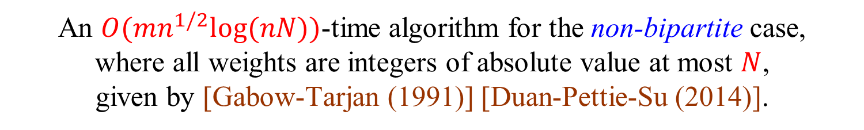
Maximum Weight Matching
The maximum matching problem in bipartite graphs can be easily reduced to a min cost flow problem.
The bipartite case, also known as the assignment problem, can be solved in $O(mn+n^{2}log⁡n)$ time [Kuhn (1955)].
The problem in non-bipartite graphs is harder. First polynomial time algorithm given by [Edmonds (1965)].
An $O(mn+n^{2}log⁡n)$-time implementation of Edmonds’ algorithm was given by [Gabow (1990) (2018)].
An $O(mn^{1/2}log⁡(nN))$-time algorithm for the non-bipartite case, where all weights are integers of absolute value at most $N$, given by [Gabow-Tarjan (1991)] [Duan-Pettie-Su (2014)].
An $O(m ε^{−1}log ε^{−1})$-time $(1−ε)$-approximation algorithm for the non-bipartite case given recently by [Duan-Pettie (2014)].

Slide 5
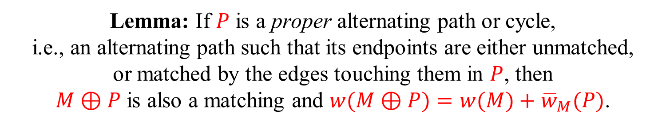
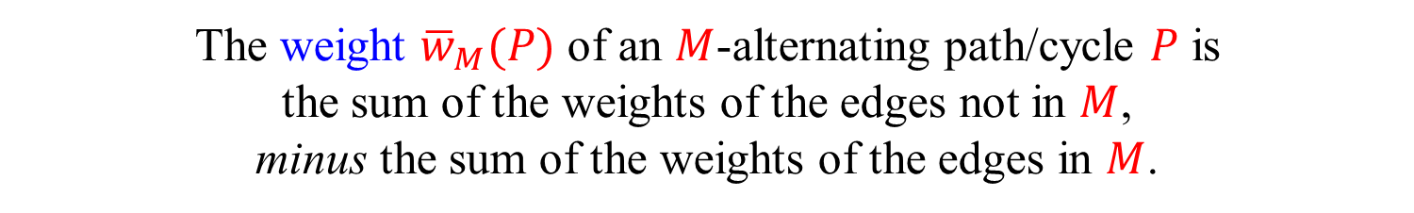
Alternating paths and cycles
The weight ${\overline{w}}_{M}(P)$ of an $M$-alternating path/cycle $P$ is the sum of the weights of the edges not in $M$, minus the sum of the weights of the edges in $M$.
+
+
−
+
−
+
−
−
+
+
−
Lemma: If $P$ is a proper alternating path or cycle, i.e., an alternating path such that its endpoints are either unmatched, or matched by the edges touching them in $P$, then $M⊕P$ is also a matching and $w(M⊕P)=w(M)+{\overline{w}}_{M}(P)$.

Slide 6
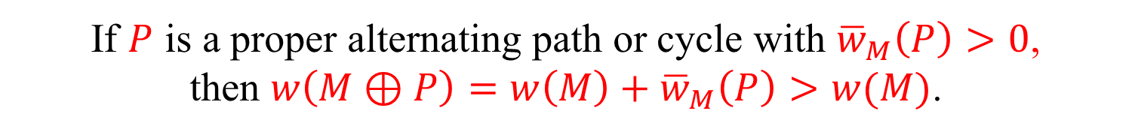
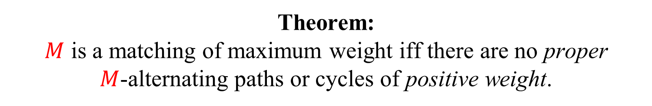
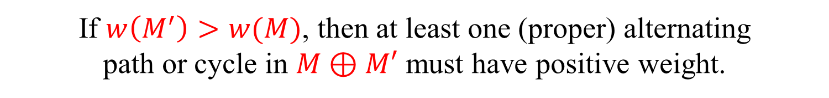
Improving paths or cycles
Theorem: $M$ is a matching of maximum weight iff there are no proper
$M$-alternating paths or cycles of positive weight.
Proof:
If $P$ is a proper alternating path or cycle with ${\overline{w}}_{M}\left(P\right)>0$, then $w\left(M⊕P\right)=w\left(M\right)+{\overline{w}}_{M}\left(P\right)>w(M)$.
If $w\left(M^{′}\right)>w(M)$, then at least one (proper) alternating path or cycle in $M⊕M′$ must have positive weight.

Slide 7
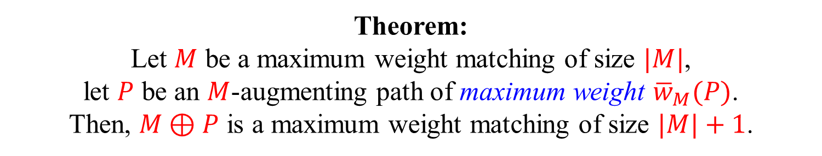
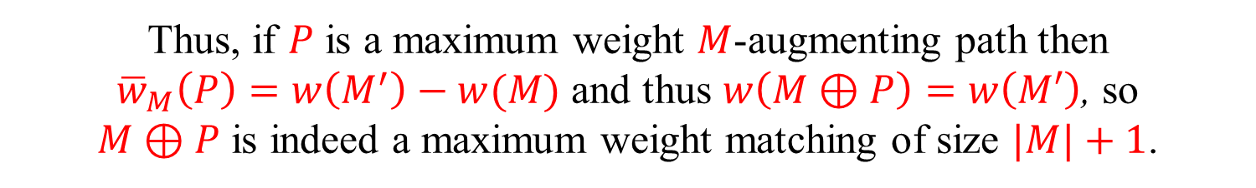
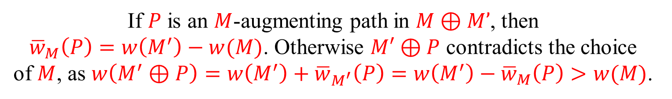
Maximum weight augmenting paths
Theorem: Let $M$ be a maximum weight matching of size $|M|$, let $P$ be an $M$-augmenting path of maximum weight ${\overline{w}}_{M}(P)$. Then, $M⊕P$ is a maximum weight matching of size $|M|+1$.
Proof:
Let $M′$ be a maximum weight matching of size $|M|+1$.
If $P$ is an $M$-augmenting path then ${\overline{w}}_{M}\left(P\right)≤w\left(M^{′}\right)−w(M)$.
If $P$ is an $M$-augmenting path in $M⊕M’$, then ${\overline{w}}_{M}\left(P\right)=w\left(M^{′}\right)−w(M)$. Otherwise $M′⊕P$ contradicts the choice of $M$, as $w\left(M^{′}⊕P\right)=w\left(M^{′}\right)+{\overline{w}}_{M^{′}}\left(P\right)=w\left(M^{′}\right)−{\overline{w}}_{M}\left(P\right)>w(M)$.
Thus, if $P$ is a maximum weight $M$-augmenting path then ${\overline{w}}_{M}\left(P\right)=w\left(M^{′}\right)−w(M)$ and thus $w\left(M⊕P\right)=w\left(M′\right)$, so $M⊕P$ is indeed a maximum weight matching of size $|M|+1$.

Slide 8
The assignment problem
The maximum weight matching problem in bipartite graphs is also known as the assignment problem.
Possible application: Assigning people to tasks. Each person can only perform a single task. Each task can only be performed by a single person.
The “Hungarian method” [Kuhn (1955)] [Jacobi (1865)?]
Efficient implementation in $O(mn+n^{2}log⁡n)$time.
We shall derive it in two different ways.

Slide 9
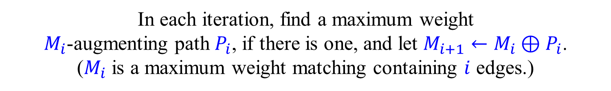


Algorithm for the assignment problem
Start with $M_{0}=∅$. (A maximum weight matching with no edges.)
In each iteration, find a maximum weight $M_{i}$-augmenting path $P_{i}$, if there is one, and let $M_{i+1}←M_{i}⊕P_{i}$. ($M_{i}$ is a maximum weight matching containing $i$ edges.)
Return the maximum weight matching found.
Can stop when the weight of $P_{i}$ is non-positive. (To be justified later.)
How do we find maximum weight augmenting paths?
In bipartite graphs, can be reduced to computing a shortest path.

Slide 10
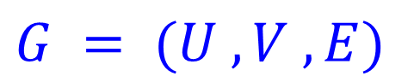
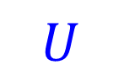
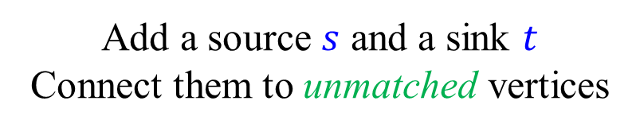
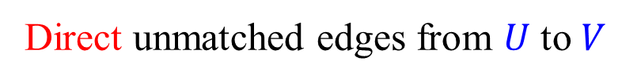

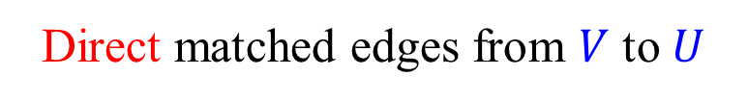
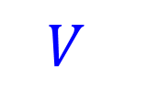
Finding maximum weight augmenting paths in bipartite graphs
$$G = (U ,V ,E)$$
Direct unmatched edges from $U$ to $V$
Direct matched edges from $V$ to $U$
Add a source $s$ and a sink $t$ Connect them to unmatched vertices
Negate the weights of the edges not in the matching
Find a shortest path from $s$ to $t$
Such a shortest path is a maximum weight augmenting path
$$U$$
$$V$$

Slide 11
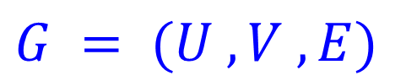
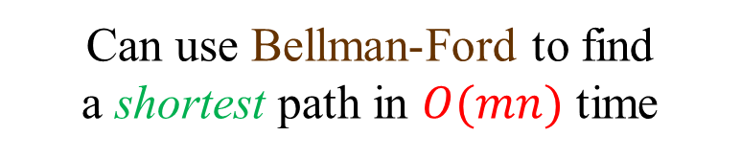
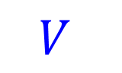
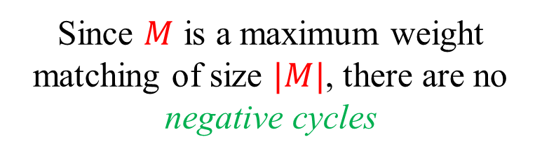
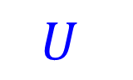
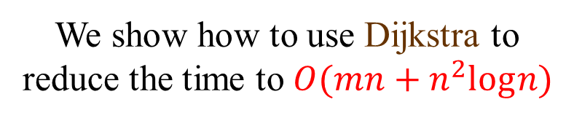
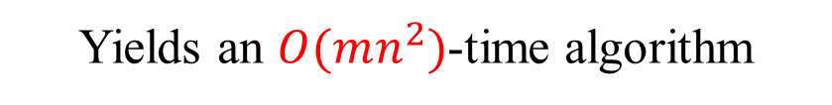
Finding maximum weight augmenting paths in bipartite graphs
$$G = (U ,V ,E)$$
Since $M$ is a maximum weight matching of size $|M|$, there are no negative cycles
Can use Bellman-Ford to find a shortest path in $O(mn)$ time
Yields an $O(mn^{2})$-time algorithm
Slow!
$$U$$
$$V$$
We show how to use Dijkstra to reduce the time to $O(mn+n^{2}log⁡n)$

Slide 12


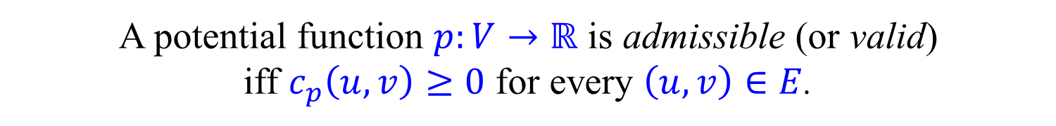
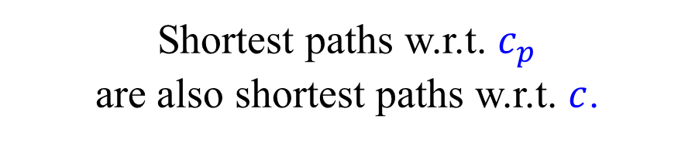
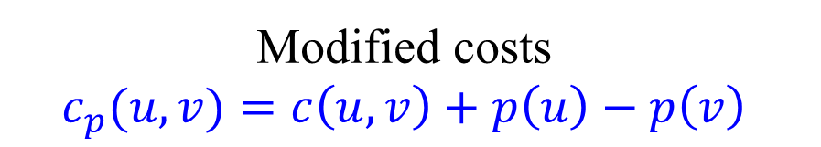
Modified costs
Cost function: $c:E→ℝ$
Potential function: $p:V→ℝ$
Modified costs $$c_{p}(u,v)=c\left(u,v\right)+p\left(u\right)−p\left(v\right)$$
Shortest paths w.r.t. $c_{p}$ are also shortest paths w.r.t. $c$.
A potential function $p:V→ℝ$ is admissible (or valid) iff $c_{p}\left(u,v\right)≥0$ for every $\left(u,v\right)∈E$.
Theorem: An admissible potential exists iff there are no negative cycles.

Slide 13
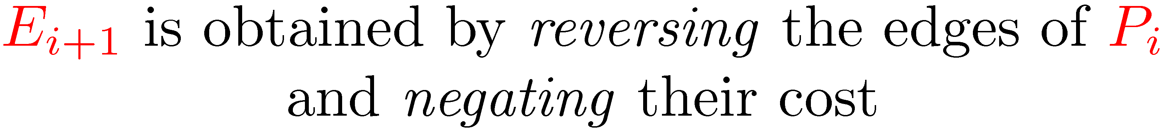
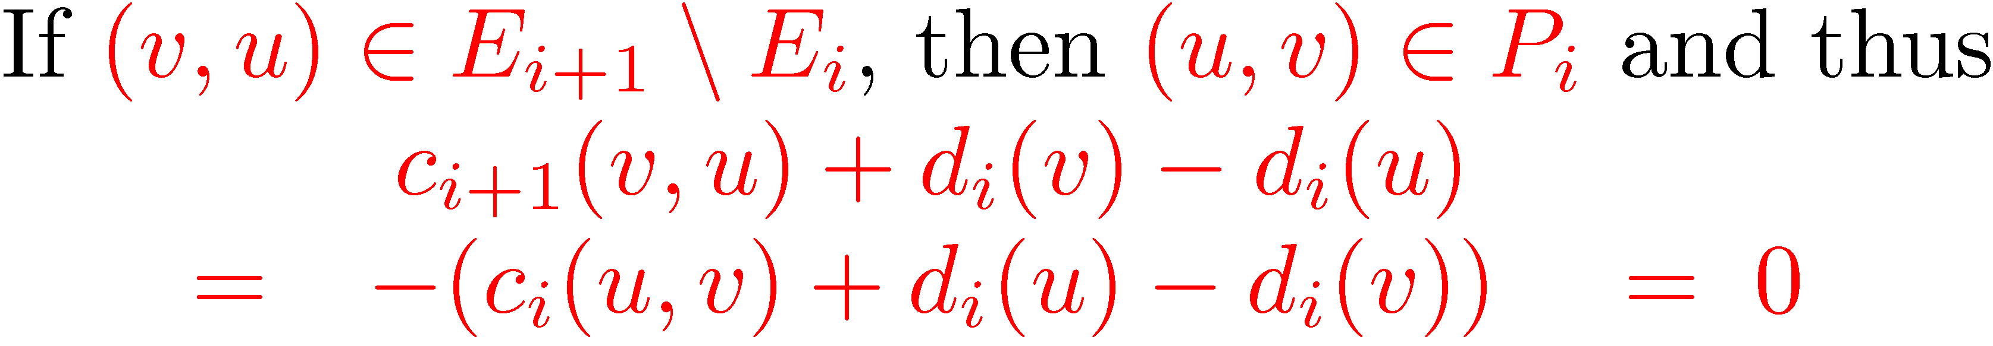
Finding augmenting paths

Slide 14
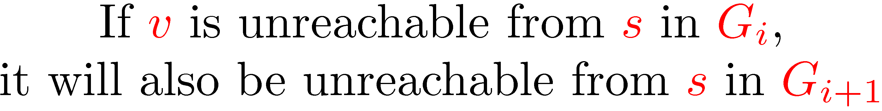
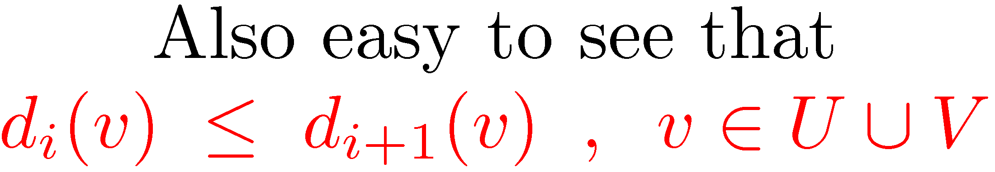

Finding augmenting paths

Slide 15
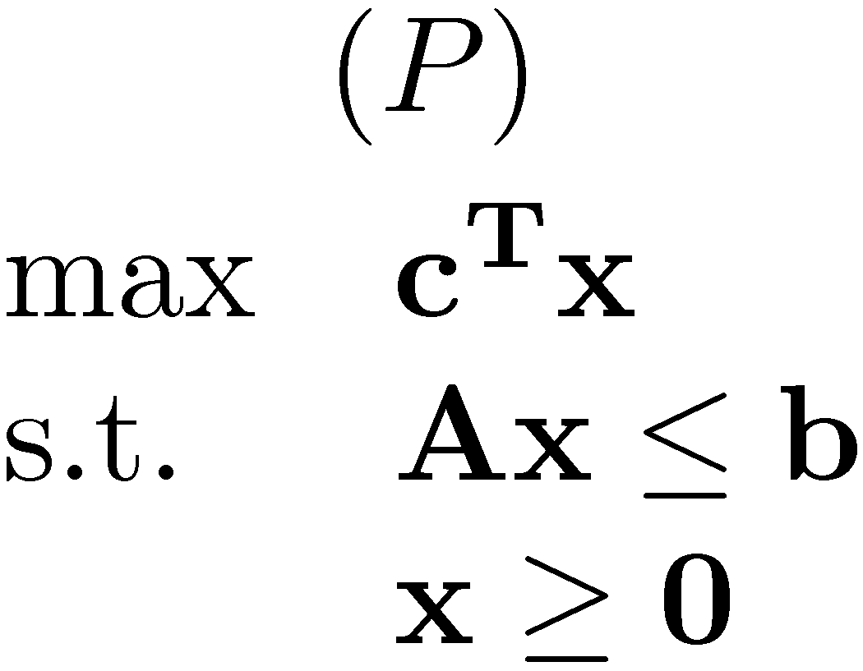
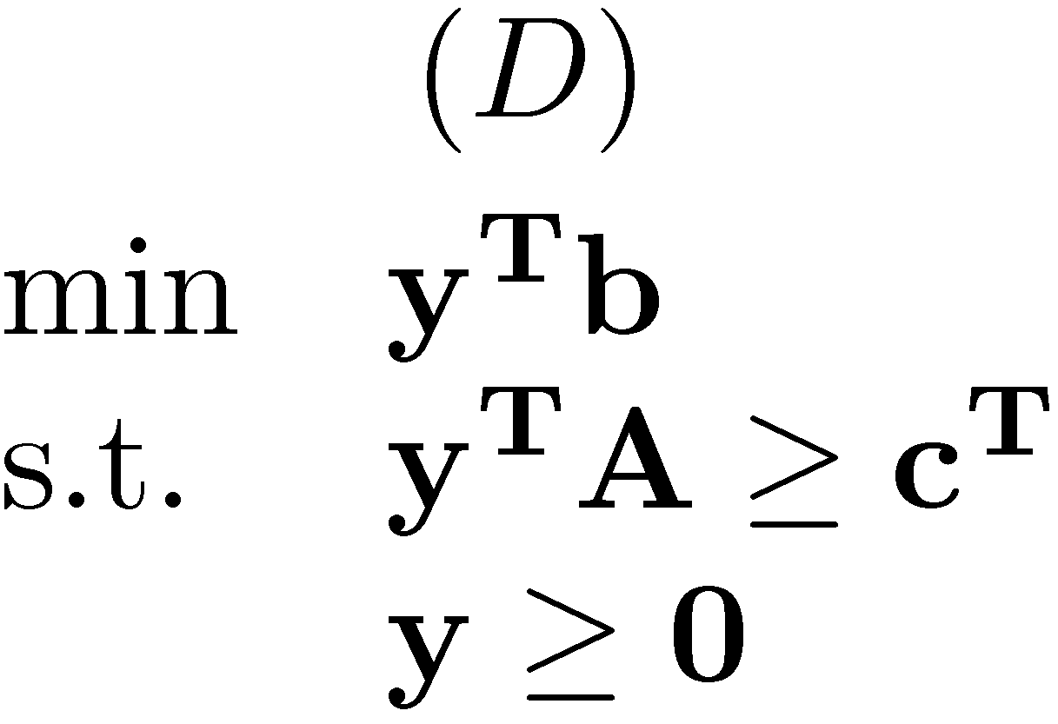
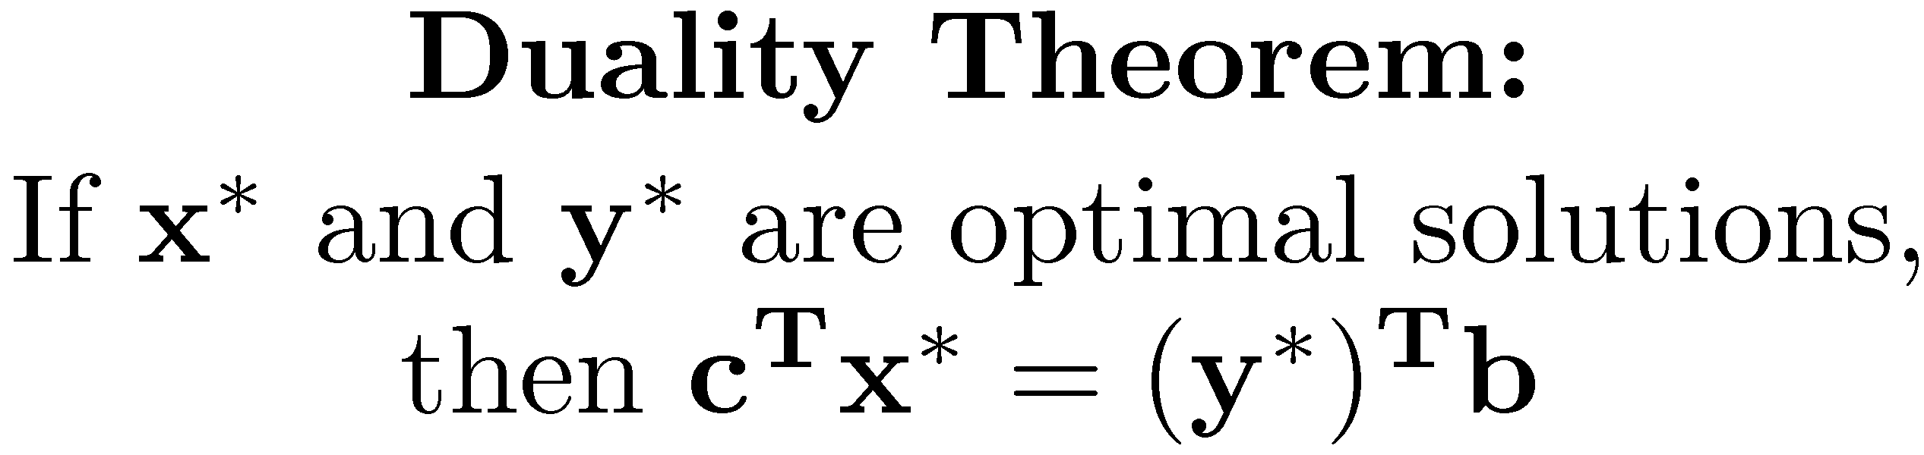
Linear Programming duality

Slide 16
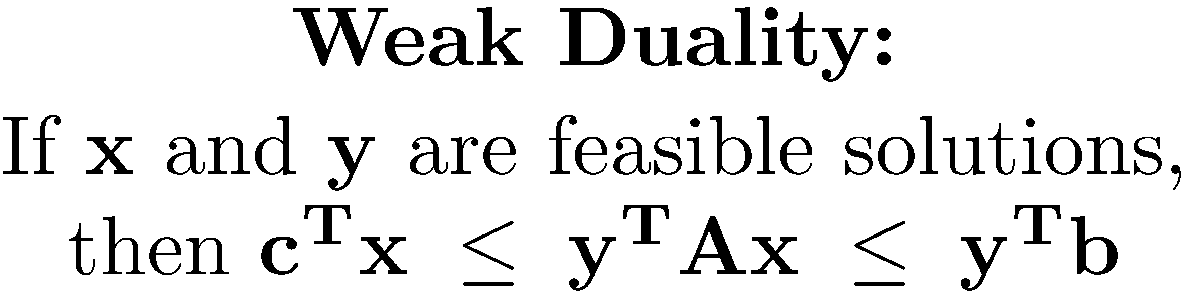
Weak duality

Slide 17
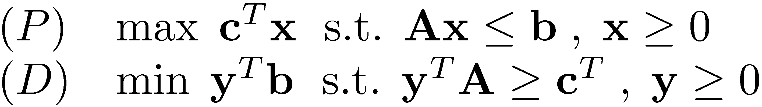
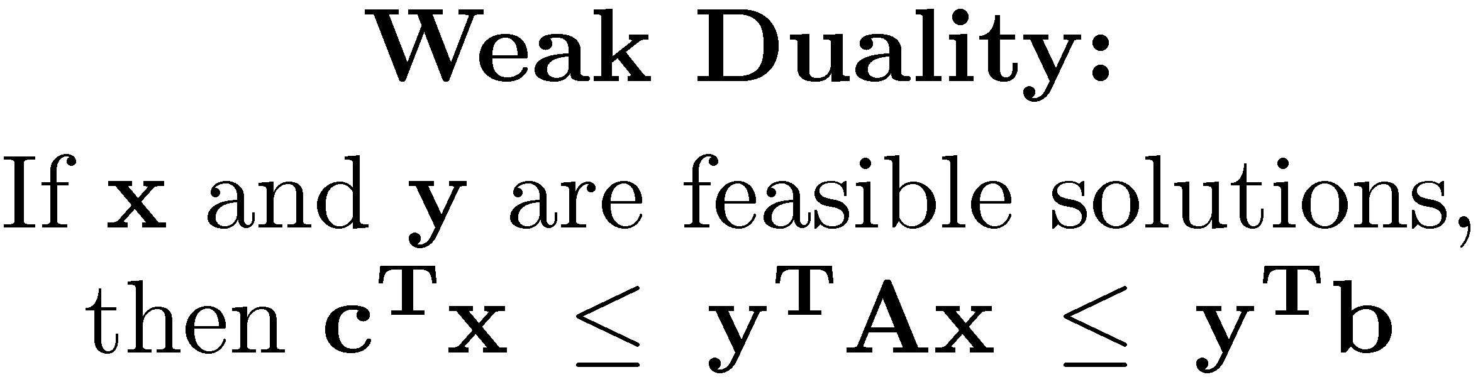
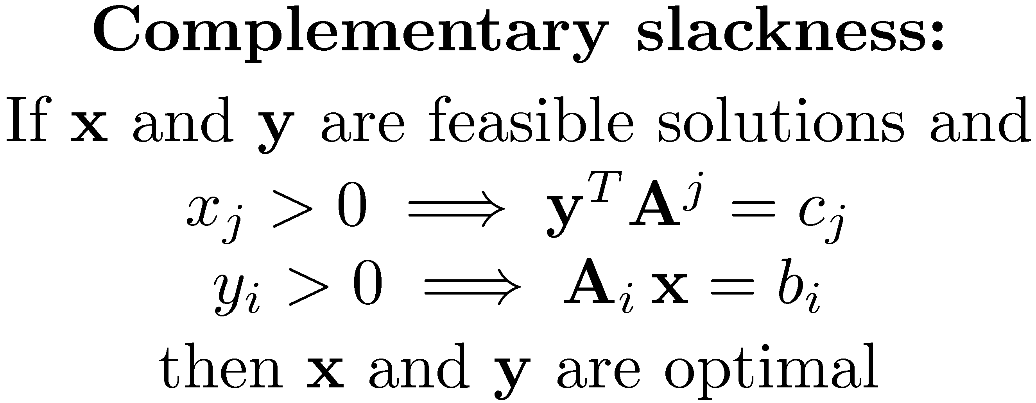
Complementary slackness

Slide 18
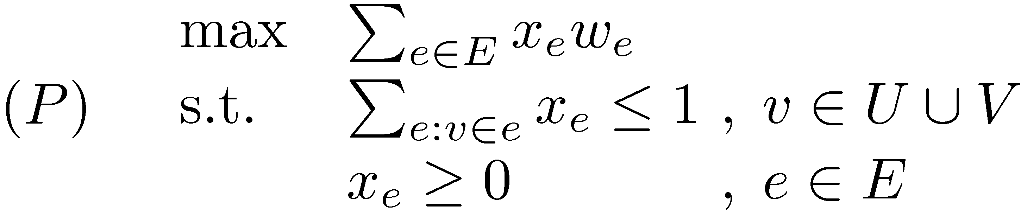
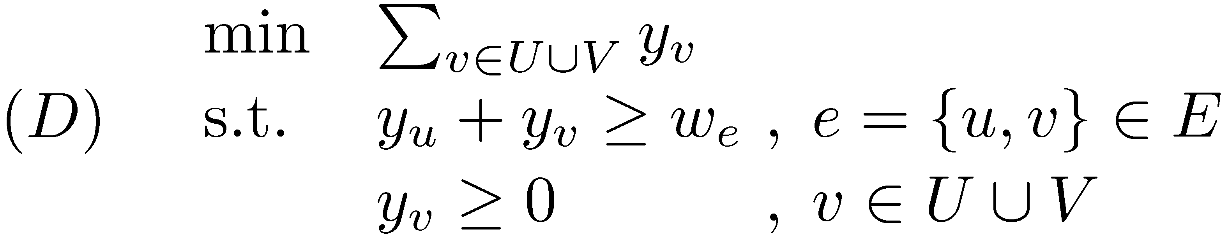
Linear Programming formulation of the assignment problem
Is this really a valid formulation?
Who says that (P) has an integral optimal solution?

Slide 19
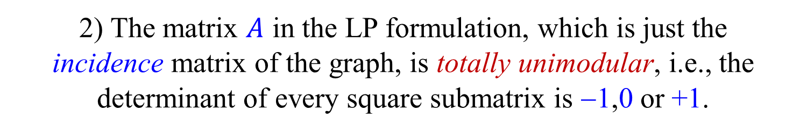
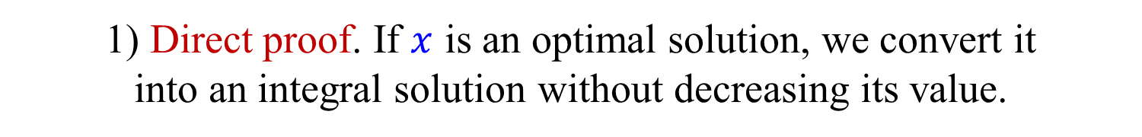
Linear Programming formulation of the assignment problem
Three different ways of showing that the formulation is valid:
1) Direct proof. If $x$ is an optimal solution, we convert it into an integral solution without decreasing its value.
2) The matrix $A$ in the LP formulation, which is just the incidence matrix of the graph, is totally unimodular, i.e., the determinant of every square submatrix is −1,0 or +1.
3) Our algorithm will always find an integral optimal solution.

Slide 20
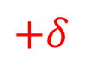
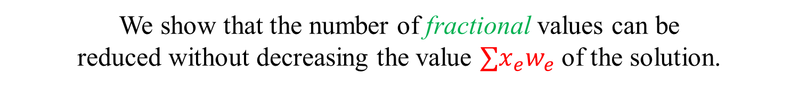
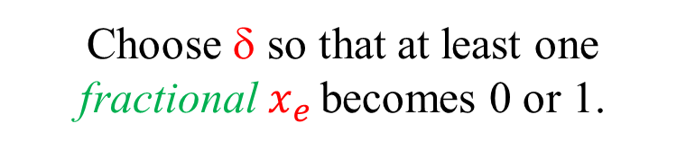

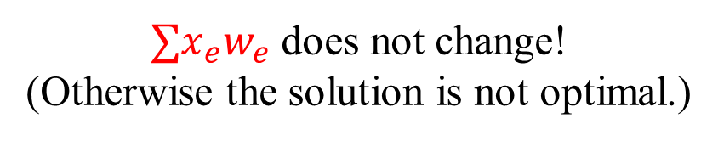
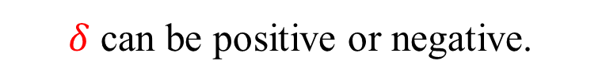
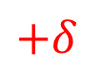
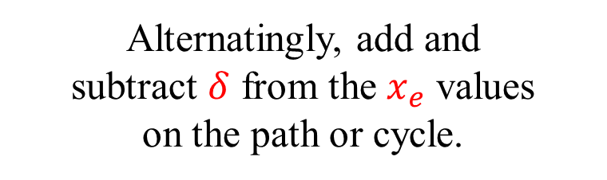

Direct proof
Let $x_{e}$ be an optimal solution and assume that some of the values are fractional, i.e., not 0 or 1.
We show that the number of fractional values can be reduced without decreasing the value $∑x_{e}w_{e}$ of the solution.
There is either a path of fractional edges between two unsaturated vertices, or an even cycle of fractional edges.
Alternatingly, add and subtract $δ$ from the $x_{e}$ values on the path or cycle.
$$+δ$$
$$−δ$$
$$+δ$$
$δ$ can be positive or negative.
$∑x_{e}w_{e}$ does not change! (Otherwise the solution is not optimal.)
Choose δ so that at least one fractional $x_{e}$ becomes 0 or 1.

Slide 21





Incidence matrix of a (bipartite) graph
Edges
$$e$$
$$u$$
1
$$U$$
Vertices
$$v$$
1
$$V$$
Every column contains exactly two 1s
The incidence matrix of a bipartite graph is totally unimodular, i.e., the determinant of every square submatrix is −1,0 or +1.

Slide 22




The primal-dual method (a.k.a the “Hungarian method”)
Keep: 1) an integral feasible primal solution, i.e., a matching $M$. 2) A dual feasible solution $y$ (not necessarily integral).
Maintain the first set of complementary slackness conditions: $\left(u,v\right)∈M$ ⇒ $y_{u}+y_{v}=w_{u,v}$
Our goal is to satisfy the second set of complementary slackness conditions: $y_{u}>0$ ⇒ $u$ matched
In each iteration we augment $M$ by only using tight edges, or adjust $y$ values so that more edges are tight.

Slide 23




The primal-dual method Preliminaries
$M=∅$ (i.e., $x_{e}=0$ , $e∈E$)
Initialization:
$$y_{u}=W=\max_{e∈E}{w_{e}}$$
, $u∈U$
$y_{v}=0$ , $v∈V$
Slacks: $s_{u,v}={ y}_{u}+ y_{v}−w_{u,v} (≥0)$
An edge $\left(u,v\right)∈E$ is tight iff $s_{u,v}=0$.
All edges of $M$ are tight.
Slacks of all edges are non-negative.

Slide 24




The primal-dual method
$$G=(U,V,E)$$
Grow an alternating forest from all unmatched vertices of $U$ using only tight edges.
Let $S$ be the vertices of $U$ in the forest, and $T$ be the vertices of $V$ in the forest.
If an augmenting path is found, augment $M$.
Keep the dual values of all vertices.
Start growing a new alternating forest w.r.t. the new matching $M^{′}.$
What do we do if we are “stuck”?
(The forest cannot be extended using tight edges and the dual variables of some unmatched vertices are still positive.)

Slide 25















Adjusting dual variables
$$−δ$$
All edges leaving the forest, from even vertices, are not tight.
$$+δ$$
$$\text{0}$$
$y_{u}←y_{u}−δ$ , $u∈S$
$$−δ$$
$$\text{0}$$
$y_{v}←y_{v}+δ$ , $v∈T$
$$\text{0}$$
$$+δ$$
$$−δ$$
$$δ_{2}=\min_{\begin{matrix}\begin{aligned}u∈S \\ v∉T\end{aligned}\end{matrix}}{s_{u,v}}$$
$$δ_{1}=\min_{u∈S}{y_{u}}$$
$$−δ$$
$$+δ$$
$$δ=\min\left\{δ_{1},δ_{2}\right\}$$
Slacks of edges connecting two vertices in the forest are unchanged.
All forest edges and matched edges are still tight.
Slacks of edges leaving the forest from even vertices decrease by $δ$.
If $δ=δ_{1}$, then $y_{u}=0$for every root $u$ and we are done! (See next slide.)
If $δ=δ_{2}$, we have at least one new tight edge.

Slide 26

Adjusting dual variables
$$−δ$$
All edges leaving the forest, from even vertices, are not tight.
$$+δ$$
$$\text{0}$$
$y_{u}←y_{u}−δ$ , $u∈S$
$$−δ$$
$$\text{0}$$
$y_{v}←y_{v}+δ$ , $v∈T$
$$\text{0}$$
$$+δ$$
$$−δ$$
$$δ_{2}=\min_{\begin{matrix}\begin{aligned}u∈S \\ v∉T\end{aligned}\end{matrix}}{s_{u,v}}$$
$$δ_{1}=\min_{u∈S}{y_{u}}$$
$$−δ$$
$$+δ$$
$$δ=\min\left\{δ_{1},δ_{2}\right\}$$
Lemma: If $u,u^{′}∈S$ are unmatched and $u^{′′}∈S$ is matched, then $y_{u}=y_{u^{′}}≤y_{u^{′′}}$.
Thus, $δ_{1}$ is the joint $y$ value of the roots.
Exercise: Are the augmenting paths found by the algorithm of maximum weight?

Slide 27


Linear Programming formulation of Single Source Shortest Paths
$\min{ \sum_{e∈E}{w_{e}x_{e}}}$
s.t. $\sum_{e∈δ^{−}\left(u\right)}{x_{e}}−\sum_{e∈δ^{+}\left(u\right)}{x_{e}}=1$ , $u∈V∖\left\{s\right\}$
$x_{e}≥0$ , $e∈E$
(P)
$\max{\sum_{v∈V}{d_{v}}}$
s.t. $d_{v}−d_{u}≤w_{u,v}$ , $\left(u,v\right)∈E$
$d_{s}=0$
(D)
The primal expresses the SSSP problem as a min cost flow problem.
The dual variables are distances. (The dual is a maximization problem.)
Complementary slackness conditions:
$x_{e}>0$ $⟹$ $d_{v}−d_{u}=w_{u,v}$ , $e=\left(u,v\right)∈E$

Slide 28
















Single Source Shortest Paths as a Min Cost Flow problem
The flow $x_{e}$ on an edge $e$ is equal to the number of root-leaf paths it participates in.
$$s$$
$$\text{8}$$
$$\text{3}$$
The net flow $\sum_{e∈δ^{−}\left(u\right)}{x_{e}}−\sum_{e∈δ^{+}\left(u\right)}{x_{e}}$ into each vertex, other than $s$, is 1.
$$\text{7}$$
$$\text{1}$$
$$\text{1}$$
$$\text{1}$$
$$\text{4}$$
$$\text{1}$$
The cost of the flow $\sum_{e∈E}{w_{e}x_{e}}$ is equal to the sum of the lengths of the root-leaf paths in the tree.
$$\text{3}$$
$$\text{1}$$
$$\text{1}$$
We are looking for a directed spanning tree rooted at $s$ that minimizes this cost.
Note that this is not the MDST problem.

Slide 29

Primal-Dual algorithm for SSSP (non-negative edge weights)
Work with: 1) an integral (infeasible) primal solution $x$, i.e., a flow tree. 2) A dual feasible solution $y$, i.e., (lower bounds on) distances.
Maintain complementary slackness:
$x_{e}>0$ $⟹$ $d_{v}−d_{u}=w_{u,v}$ , $e=\left(u,v\right)∈E$
Satisfy more and more primal constraints until the primal solution is feasible and hence also optimal.
$x_{e}=0$ , $e∈E$
Start with:
$y_{v}=0$ , $v∈V$

Slide 30











Primal-Dual algorithm for SSSP (non-negative edge weights)
$$s$$
Edges in the tree are tight: $y_{v}−y_{u}=w_{u,v}$
Grow step
If $\left(u,v\right)$ is a tight edge leaving the tree:
Add $\left(u,v\right)$ to the tree.
$$u$$
Increase the flow on the $s$-$v$ path by 1.
Dual adjustment step
$$v$$
$$+δ$$
$$+δ$$
If there are no tight edges leaving the tree:
$y_{v}←y_{v}+δ$ , $v∉T$
Looks familiar?
$$δ=\min_{\begin{aligned}u∈T \\ v∉T\end{aligned}}{{ w}_{u,v}− d_{u}+d_{v}}$$
Dijkstra!

Slide 31


Linear Programming formulation of the general weighted matching problem [Edmonds (1965)]
Enough to have $|B|$ odd.
(P) has an exponential number of constraints.
(D) has an exponential number of variables.

Slide 32
Linear Programming formulation of the general weighted matching problem [Edmonds (1965)]
Correctness of formulation would follow from algorithm.
$B$ with $z_{B}>0$are blossoms.
Note the similarity of dual with odd vertex cover.

Slide 33



The Primal-dual method The non-bipartite case
Primal solution:
A matching $M$.
Dual values $y_{v}≥0$, for $v∈V\text{.}$ A collection of (nested) blossoms. A dual value $z_{B}≥0$ for each blossom $B$.
Dual solution:
Slacks: $s_{e}=y_{u}+y_{v}+\left(\sum_{B:e⊂B}{z_{B}}\right) −w_{e}$ , $e=\left\{u,v\right\}$
A blossom $B$ is $M$-full, i.e., it contains $(\left|B\right|−1)/2$ edges of $M$.

Slide 34



The Primal-dual method The non-bipartite case
Primal solution:
A matching $M$.
Dual values $y_{v}≥0$, for $v∈V\text{.}$ A collection of (nested) blossoms. A dual value $z_{B}≥0$ for each blossom $B$.
Dual solution:
Complementary slackness conditions:
$$\begin{matrix}(1) & e∈M & ⟹ & s_{e}=0 \\ (2) & y_{v}>0 & ⟹ & v \text{is} M\text{−}\text{matched} \\ (3) & z_{B}>0 & ⟹ & B \text{is} M\text{−}\text{full}\end{matrix}$$
The algorithm maintain (1) and (3). Makes progress towards (2).

Slide 35

Correctness
If the algorithm terminates, correctness follows from weak duality.
Or directly:
Let $M$ be the matching found and $M′$ an arbitrary matching

Slide 36
More fun with blossoms
In the cardinality case, after each augmentation we expanded all blossoms and started from scratch.
We cannot do it here, as blossoms now have dual values.
Lemma: A blossom remains a blossom after an augmentation, possibly with no stem.
We thus start each phase with a collection of blossoms.
During a phase, new blossoms may be formed, and existing blossoms may be expanded.
In the cardinality case, blossoms were always even.
Blossoms may now be added as odd vertices.

Slide 37
The effect of an augmentation on a blossom

Slide 38
The alternating forest
All vertices are blossoms. (Some nested, some trivial.)
All edges in the forest are tight.
All edges in blossoms are tight, even if they are not in the forest.
When there are no more tight edges to explore, adjust dual variables.

Slide 39


The Primal-dual method Initialization
$$M=∅$$
Start with:
$y_{v}=\frac{1}{2}\max_{e∈E}{w_{e}} , v∈V$
No blossoms
All primal and dual constraints are satisfied.
Conditions (1) and (3) are satisfied vacuously.

Slide 40







Adjusting dual variables
$S$ – vertices contained in even blossoms (in the forest).
$T$ – vertices contained in odd blossoms (in the forest).
All edges leaving the forest, from even vertices, are not tight.

Slide 41

Changes in slacks

Slide 42


Case 1: $δ=δ_{1}=\min_{u∈S}{y_{u}}$
After the update, $y_{v}=0$, for every unmatched $v$.
All complementary slackness conditions are satisfied.
We are done!
Case 2: $δ=δ_{2}=\min_{\begin{aligned}u∈S \\ v∉S∪T\end{aligned}}{s_{u,v}}$
After the update, at least one more edge leaving the forest from an even vertex is tight.
We can extend the forest while keeping all invariants.

Slide 43


Case 3: $δ=δ_{3}=\min_{\begin{aligned}u,v∈S \\ B\left(u\right)≠B\left(v\right)\end{aligned}}{\frac{s_{u,v}}{2}}$
An edge connecting two even vertices in different blossoms becomes tight.
If the blossoms are in different trees ⇒ augmenting path
Otherwise, a new even blossom $B$ is formed. Set $z_{B}←0$.
The new even blossom swallows some odd blossoms. All vertices in these blossoms become even and tight edges leaving them may be explored.

Slide 44


Case 4: $δ=δ_{4}=\min_{B⊆T}{\frac{z_{B}}{2}}$
$z_{B}$ becomes 0, for some odd blossom $B$.
Expand the odd blossom $B$.
New even blossom
$$B$$
These blossoms leave the forest

Slide 45


Number of steps
Does the algorithm terminate?
The algorithm is composed of at most $n/2$ phases in which an augmenting path is found.
After each adjustment of the dual variables, either we are done, or an augmenting path is found, or a new even blossom is formed, or an old odd blossom is expanded.
Thus, in each phase there are at most $O(n)$ adjustments of the dual variables.
Total number of dual adjustment steps is $O(n^{2})$.
Algorithm is polynomial! [Edmonds (1965)]

Slide 46

Efficient implementation
Maintaining blossoms and finding augmenting paths
More complicated than the unweighted case. We need to explicitly maintain the structure of blossoms to be able to expand them.
Maintaining slacks and computing $δ$
Completely naïve implementation of each step in $O(m)$ time, giving an $O(mn^{2})$-time algorithm.
Using some (sophisticated) data structures the total running time can be reduced to:
$O(n^{3})$ [ Gabow (1976) ] [ Lawler (1976) ]
$O(mn\log{n})$ [ Galil-Micali-Gabow (1986) ]
$O(mn +n^{2}\log{n})$ [ Gabow (1990) (2018) ]
Matching the best running time for weighted bipartite matching!

Slide 47
Evolution of blossoms
Each search start with a collection of blossom, inherited from the previous search.
Blossoms form a laminar structure, naturally represented by trees.
Initially, unmatched blossoms are even, all other are out.
Grow steps add an odd blossom and an even blossom to the alternating forest.
Blossom steps create a new even blossom composed of previous even and odd blossoms.
Expand steps break an odd blossom into even, odd and out blossoms.

Slide 48
Maintaining blossoms
Each maximal blossom is explicitly represented by a tree.
The children of a blossom are its sub-blossoms.
The leaves are the original vertices. (Considered to be degenerate blossoms.)
Even blossoms may grow.
Odd blossoms may split.
Out blossoms remain unchanged until they enter the alternating forest. (They can enter as either even or odd.)
A blossom enters or leaves the alternating forest only once.

Slide 49




















Representing blossoms
$B$
$$B$$
$$B_{0}$$
$$B_{1}$$
$$B_{2}$$
$$B_{3}$$
$$B_{4}$$
$$B_{3}$$
$$B_{4}$$
$B.base$ – the base of $B$. (Possibly only for maximal blossoms.)
$$B_{2}$$
$B.child$ – the first sub-blossom of $B$.
$$x$$
$B.right$ – the right sibling of $B$.
$$b$$
$B$ and $B.right$ connected by the edge $\left(B.x,B.right.y\right)$.
$$y$$
$$B_{0}$$
$$B_{1}$$
$B.left$ – the left sibling of $B$.

Slide 50













Maintaining even blossoms
Use a union-find data structure.
If $u$ is even, then $find_{0}(u)$ is the maximum (even) blossom currently containing $u$.
$$B_{10}$$
Each vertex $u$ has a field $u.even$ that says whether it is even or not.
$$B_{7}$$
$$B_{8}$$
$$B_{1}$$
$$B_{2}$$
$$B_{5}$$
$$B_{6}$$
$$B_{3}$$
$$B_{4}$$
$$B_{9}$$
(Sequence of unions not known in advance, but there are some restrictions on the possible sequences. Can be used to obtain $O(1)$ finds on a RAM.)

Slide 51






















Even alternating paths in blossoms
Reminder:
$$B$$
$$B_{1}$$
$$b_{1}$$
$$x_{1}$$
Lemma: If $B$ is a blossom with base $b$ and $u∈B$, then there is an even alternating path $P_{B}(u,b)$ from $u$ to $b$ in $B$, starting with a match edge.
$$B_{0}$$
$$b_{0}$$
$$B_{2}$$
$$x_{2}$$
$$u$$
Proof: By induction on the depth of $B$.
$$b_{2}$$
Let $B_{0},B_{1},…$ be the sub-blossoms of $B$.
Assume that $u∈B_{0}$ and $b∈B_{k}$, $k$ even. (If $k$ is odd go in the other direction.)
$$b_{3}$$
$$b$$
$$x_{4}$$
$$x_{3}$$
Let $b_{0}b_{1},x_{1}x_{2},b_{2}b_{3},…,x_{k−1}x_{k}$ be the edges of the even alternating path from $B_{0}$ to $B_{k}$ in $B$.
$$B_{4}$$
$$B_{3}$$
$P_{B}\left(u,b\right) = P_{B_{0}}\left(u,b_{0}\right) b_{0}b_{1} P_{B_{1}}\left(b_{1},x_{1}\right) x_{1}x_{2}$ $$P_{B_{2}}\left(x_{2},b_{2}\right)…P_{B_{k−1}}\left(b_{k−1},x_{k−1}\right) x_{k−1}x_{k} P_{B_{k}}\left(x_{k},b_{k}\right)$$
Exercise: Is this necessarily the only such path?

Slide 52



Finding even alternating paths
To apply this recursive construction we need to know $B_{0}$, the top sub-blossom containing $u$, and similarly in all recursive calls.
Exercise: Suggest a way of solving this ‘small’ problem.
We describe a ‘clever’ alternative recursive definitions of the paths.
Each defining edge $xy$ of a blossom $B$ keeps pointers to the two uniquely defined (arbitrarily deep) sub-blossoms of $B$ that it connects.
Let $uv$ be the matched edge of $u$.
Let $B_{0}$ and $B_{1}$ be the sub-blossoms connected by $uv$, where $u∈B_{0}$.
Let $B_{2}$ be the other sibling of $B_{1}$, and let $xy$ be the edge connecting $B_{1}B_{2}$
Lemma: $P\left(u,b\right)=uv P{\left(x,v\right)}^{R} xy P\left(y,b\right)$ ($R$ = Reverse)
Exercise: Prove the lemma. Show that this gives a recursive procedure that does not need to receive $B$ as an argument. Are the paths obtained the same?

Slide 53

Finding augmenting paths
Using $P(u,b)$, we can easily find an even alternating path from an even vertex $u$ to the root of its tree.
We can thus efficiently find augmenting paths.
Exercise: Work out the exact details.
Exercise: What changes in the representation of blossoms after the application an augmenting path?

Slide 54











Maintaining non-even blossoms
Use a split-find data structure.
If $u$ is not even, $find_{1}(u)$ is the maximum (non-even) blossom currently containing $u$.
$$B_{10}$$
$$B_{7}$$
$$B_{8}$$
$$B_{9}$$
$$B_{1}$$
$$B_{2}$$
$$B_{5}$$
$$B_{6}$$
$$B_{3}$$
$$B_{4}$$
The splits are known in advance. Their timing is not.
Number the vertices in each initial blossom such that the numbers of the vertices in each sub-blossom form a contiguous sequence (an interval).
For each (sub-)blossom keep the endpoints of the sequence.

Slide 55



Split-Find
Maintain a collection of sub-sequences of an initial sequence $[x_{1},x_{2},…,x_{n}]$.
Each item $x$ has a field $x.ind$ that gives its position in the sequence.
$Split(x)$ – Split the current sequence $[x_{j},…,x_{i},…,x_{k}]$ containing ${x=x}_{i}$ into the two sequences $[x_{j},…,x_{i−1}]$ and $[x_{i},…,x_{k}]$.
$Find(x)$ – Return the current sequence containing $x$.
A sequence of $m$ operations on $n$ items can be processed, on a pointer machine, in $O\left(mα\left(m,n\right)\right)$ time [ Gabow (1985) ] .
On a pointer machine this is tight [ La Poutré (1990) ].
We will soon need a generalization called Split-Findmin.

Slide 56








Implementing dual adjustments steps
$$δ_{2}=\min_{\begin{aligned}u∈V_{0} \\ v∈V_{∅}\end{aligned}}{s_{u,v}}$$
$$δ_{3}=\min_{\begin{aligned}u,v∈V_{0} \\ B\left(u\right)≠B\left(v\right)\end{aligned}}{\frac{s_{u,v}}{2}}$$
$$δ_{4}=\min_{B⊆V_{1}}{\frac{z_{B}}{2}}$$
$$δ_{1}=\min_{u∈V_{0}}{y_{u}}$$
$y_{u}←y_{u}−δ$ , $u∈V_{0}$ $y_{u}←y_{u}+δ$ , $u∈V_{1}$
$z_{B}←z_{B}+2δ$ , $B⊂V_{0}$ (top level) $z_{B}←z_{B}−2δ$ , $B⊂V_{1}$ (top level)
The quantities $y_{u}$, $s_{u,v}$ and $z_{B}$ change with ‘time’.
It is too expensive to update all of them explicitly.
It is too expensive to compute $δ_{1},δ_{2},δ_{3},δ_{4}$ naively.
Let $Δ=Δ_{total}$ be the sum of all $δ$’s in the current search. (May be viewed as representing ‘time’.)
For each vertex $v$, edge $(u,v)$ and each odd blossom $B$, keep the (future) value of $Δ$ in which $y_{u}$, $s_{u,v}$ or $z_{B}$ becomes 0.
Keep a global heap to find the next ‘tightness event’.

Slide 57


Tightness events
Let $Δ=Δ_{total}$ be the sum of all $δ$’s in the current search. (May be viewed as representing ‘time’.)
$δ_{1},δ_{2},δ_{3},δ_{4}$ represent four types of events:
The algorithm should terminate.
The alternating forest can be grown.
A new even blossom is formed, or an augmenting path is found.
An odd blossom should be expanded.
Let $Δ_{1},Δ_{2},Δ_{3},Δ_{4}$ be the values of $Δ$in which an event of the corresponding type would occur.
Keep a global heap $H$ to find the next ‘tightness event’.

Slide 58

























$y_{u}$ as a function of $Δ$
$$y_{u}$$
$Δ_{0}\left(B_{3}\right)−Δ_{1}\left(B_{2}\right)≤\frac{1}{2}z_{0}\left(B_{2}\right)$
$Y\left(u\right)−Δ$
$\frac{1}{2}z_{0}\left(B_{1}\right)$
$$y_{0}(u)$$
$$Δ$$
$$0$$
$$Δ_{1}\left(B_{1}\right)$$
$$Δ_{1}\left(B_{2}\right)$$
$$Δ_{0}\left(B_{3}\right)$$
$$Δ_{0}\left(B_{4}\right)$$
$u∈B_{1}$
$u∈B_{2}$
$u∈B_{3}$
$u∈B_{4}$
$$B_{1}$$ out
$$B_{1}$$ odd
$$B_{2}$$ out
$$B_{2}$$ odd
$$B_{3}$$ even
$$B_{4}$$ even
$B_{1}$ is expanded
$B_{3}$ swallowed by $B_{4}$
$B_{2}$ swallowed by $B_{3}$

Slide 59



Recording ‘history’
$Δ=Δ_{total}$ – The total of all $δ$’s applied so far.
$y_{0}\left(u\right)$ – value of $y_{u}$ at the beginning of current search.
$z_{0}\left(B\right)$ – value of $z_{B}$ at the beginning of current search.
$Δ_{0}\left(B\right)$ – the value of $Δ$ when (and if) $B$ became part of an even blossom.
$Δ_{1}\left(B\right)$ – the value of $Δ$ when (and if) $B$ became an odd blossom.
$δ\left(B\right)$ – sum of all $δ$’s while $B$ was part of an odd blossom.
If $B$ is a maximal odd blossom, $δ(B)$ does not include the sum of the $δ$’s since $B$ became a maximal blossom.

Slide 60
Updating ‘history’
After each dual adjustment step: $Δ←Δ+δ$
(Actually the new $Δ′$ is computed directly and $δ=Δ^{′}−Δ$.)
If a grow step adds $B_{0}$ and $B_{1}$ as an even and odd blossoms:
$Δ_{0}\left(B_{0}\right)←Δ$ , $Δ_{1}\left(B_{1}\right)←Δ$
If a blossom step creates a new even blossom $B$ composed of $B_{1},…,B_{k}$:
$$Δ_{0}\left(B\right)←Δ$$
$δ\left(B_{i}\right)←δ\left(B_{i}\right)+\left(Δ−Δ_{1}\left(B_{i}\right)\right)$ , if $B_{i}$ odd
If an expand step splits a blossom $B$ into $B_{1},…,B_{k}$:
$Δ_{0}\left(B_{i}\right)←Δ$ , if $B_{i}$ even
$Δ_{1}\left(B_{i}\right)←Δ$ , if $B_{i}$ odd
$δ\left(B_{i}\right)←δ\left(B\right)+\frac{1}{2}z_{0}\left(B\right)$ , for $i=1,2,…,k$.

Slide 61




Maintaining $y_{u}$ and $z_{B}$
Let $B=B\left(u\right)=find_{1}(u)$.
If $u$ is not even, $B$ is be the current maximal blossom containing $u$.
If $u$ is even, $B$ is be the max blossom containing $u$ just before it became even.
$$y_{u}=y_{0}\left(u\right)+\left\{\begin{matrix}δ\left(B\right) & u out \\ δ\left(B\right)+\left(Δ−Δ_{1}\left(B\right)\right) & u odd \\ δ\left(B\right)−\left(Δ−Δ_{0}\left(B\right)\right) & u even\end{matrix}\right.$$
When $u$ becomes even, let $Y\left(u\right)=δ\left(B\right)+Δ_{0}\left(B\right)$, so from now on, $y_{u}=Y\left(u\right)−Δ$.
For any blossom $B$:
$$z_{B}=z_{0}\left(B\right)+2×\left\{\begin{matrix}0 & B not maximal \\ −δ\left(B\right) & B out \\ −δ\left(B\right)−\left(Δ−Δ_{1}\left(B\right)\right) & B odd \\ −δ\left(B\right)+\left(Δ−Δ_{0}\left(B\right)\right) & B even\end{matrix}\right.$$

Slide 62

Tracking the stopping condition - $Δ_{1}$
$Δ_{1}=\frac{1}{2}\max_{e∈E}{w_{e}}$
This value never changes.
Insert an even STOP with key $\frac{1}{2}\max_{e∈E}{w_{e}}$ into the heap $H$.

Slide 63

Computing slacks $s_{u,v}$
We are interested in $s_{u,v}$ where $u,v$ and not in the same blossom.
In such a case: $s_{u,v}=y_{u}+y_{v}−w_{u,v}$
Consider first the case $u∈V_{0}$ , $v∈V_{∅}$, needed for computing $Δ_{2}$.
Let $B_{1}$ be the max. blossom containing $v$. (May change over time.)
$$y_{u}=Y\left(u\right)−Δ$$
$$y_{v}=y_{0}\left(v\right)+δ\left(B_{1}\right)$$
Let ${\overline{s}}_{u,v}=Y(u)+y_{0}\left(v\right)−w_{u,v}$
${\overline{s}}_{u,v}$ is computed when $u$ becomes even and never changes.
$$s_{u,v} = {\overline{s}}_{u,v}+ δ\left(B_{1}\right)−Δ$$
$(u,v)$ becomes tight when $Δ=Δ\left(u,v\right)={\overline{s}}_{u,v}+ δ\left(B_{1}\left(v\right)\right)$.
We only need to find the smallest such $Δ$.

Slide 64




Tracking grow events – $Δ_{2}$
Edge $\left(u,v\right)$ becomes tight when $Δ={\overline{s}}_{u,v}+ δ\left(B_{1}\left(v\right)\right)$.
We do not want to reschedule an event when $B_{1}\left(v\right)$ changes.
We have an event for each out blossom, not for individual edges.
$$key\left(v\right) =\min_{\begin{matrix}\left(u,v\right)∈E \\ u∈V_{0} , v∉V_{0}\end{matrix}}{{\overline{s}}_{u,v}}$$
$$key\left(B\right)=δ\left(B\right)+\min_{v∈B}{key(v)}$$
Let $v.edge$ and $B.edge$ the edges which achieve the mins.
If $B$ is out, then $key(B)$ is the smallest $Δ$ for which an edge ($B.edge$) to a vertex $v∈B$ from an even vertex $u$ becomes tight.
We maintain $key(B)$ for both odd and out blossoms. (Why?)
For each out blossom $B$ we have an event.
Add $B$ to the global heap $H$ with key $key(B)$.
How do we maintain $key(v)$ and $key\left(B\right)$?

Slide 65






Maintaining $key(v)$ and $key(B)$
$$key\left(v\right) =\min_{\begin{matrix}\left(u,v\right)∈E \\ u∈V_{0} , v∉V_{0}\end{matrix}}{{\overline{s}}_{u,v}}$$
$$key\left(B\right)=δ\left(B\right)+\min_{v∈B}{key(v)}$$
When a vertex $u$ becomes even, examine every edge $\left(u,v\right)∈E$, where $v∉V_{0}$, compute ${\overline{s}}_{u,v}$ and decrease $key(v)$ if necessary.
For each non-even blossom $B$ use a split-findmin data structure to maintain $\min_{v∈B}{key(v)}$.
Do a $decrease$-$key$ to decrease $key(B)$ in $H$, if necessary.
When an out blossom $B$ enters the forest, delete $B$ from $H$.
When an odd blossom $B$ is expanded, do split operations to compute ${key(B}_{1}),key\left(B_{2}\right),…,key(B_{k})$ of the sub-blossoms of $B$.
Insert the new out blossoms into the global heap $H$.

Slide 66



Split-Findmin
Maintain sub-sequences of an initial sequence $[x_{1},x_{2},…,x_{n}]$.
Each item $x$ has a field $x.ind$ that gives its position in the sequence.
Each item $x$ has a key $x.key$
$Split(x)$ – Split the current sequence $[x_{j},…,x_{i},…,x_{k}]$ containing ${x=x}_{i}$ into the two sequences $[x_{j},…,x_{i−1}]$ and $[x_{i},…,x_{k}]$.
$Find(x)$ – Return the current sequence containing $x$.
$Findmin(x)$ – Return an item of minimum key in the sequence currently containing $x$.
$Decreasekey(x,b)$ – Decrease the key of $x$ to $b$.
A sequence of $m$ operations on $n$ items can still be processed, on a pointer machine, in $O\left(mα\left(m,n\right)\right)$ time [ Gabow (1985) ].
Can be improved to $O\left(m\log{α\left(m,n\right)}\right)$ on a RAM [ Pettie (2005,2015) ].
Can be improved to $O\left(m+n\right)$ on a word-RAM [ Thorup (1999) ].

Slide 67
Split-Findmin – simple solution
Simple solution with total time $O\left(m+n\log{n}\right)$. (Enough for us.)
Each sequence is broken into blocks of length $2^{i}$ for some $i≥0$.
The sizes of the blocks are bitonic – first strictly increasing then strictly decreasing. (The two blocks in the “middle” can have equal size.)
When a sequence is split in the middle of a block, partition the block into decreasing and then increasing blocks
(The binary representation gives a unique way of doing it.)
The blocks in the two subsequences are again bitonic.

Slide 68
Split-Findmin – simple solution
Each item knows the block it belongs to.
Maintain the position of the min in each sequence and each block.
Find-min: Return the min.
Decrease-key: Change the min of the block containing the item, and if necessary, the min of the sequence containing the item.
Split: Find the min in each new block and in the two new sequences. (In one of them, we already know the min.)
Find-min and Decrease-key take $O(1)$ time.
The blocks containing a given item decrease in size.
Thus, each item is contained in at most $\log{n}$ different blocks.
Total time spend on finding the min of new blocks is $O\left(n\log{n}\right)$.
Each sequence is composed of at most $2\log{n}$ blocks.
Computing the min of a new sequence takes $O\left(\log{n}\right)$ time.
Total time spend on finding the min of new sequences is $O\left(n\log{n}\right)$.

Slide 69




Tracking blossom/augment events – $Δ_{3}$
If $\left(u,v\right)∈E$ and $u,v∈V_{0}$ then
$s_{u,v} = y_{u}+y_{v}−w_{u,v}=Y\left(u\right)+Y\left(v\right)−w_{u,v}−2Δ$
$\left(u,v\right)$ becomes tight when $Δ=\frac{{\overline{s}}_{u,v}}{2}$.
$$={\overline{s}}_{u,v}$$
We want to maintain $Δ_{3}=\min_{\begin{aligned}u,v∈V_{0} \\ B\left(u\right)≠B\left(v\right)\end{aligned}}{\frac{{\overline{s}}_{u,v}}{2}}$
When $Δ=\frac{{\overline{s}}_{u,v}}{2}$, $u$ and $v$ may already be in the same blossom.
Simple $O\left(m\log{n}\right)$ solution:
Maintain a heap $H_{3}$ with all the even-even edges.
The key of an edge $\left(u,v\right)$ is $\frac{{\overline{s}}_{u,v}}{2}$.
To find $Δ_{3}$ repeatedly do delete-min on $H_{3}$ until the returned edge connects vertices in different blossoms.
To reduce the time to $O(m+n\log{n})$ we need to work harder.

Slide 70


Tracking expand events – $Δ_{4}$
When a blossom $B$ becomes odd, insert $B$ into $H$ with $key\left(B\right)=\frac{1}{2}z_{0}\left(B\right)−δ\left(B\right)+Δ_{1}\left(B\right)$.
(Recall that $z_{B}=z_{0}\left(B\right)−2δ\left(B\right)−2\left(Δ−Δ_{1}\left(B\right)\right)$.)
When a blossom $B$ stops being odd, delete $B$ from $H$.
Each blossom is inserted at most once and deleted at most once.
Total running time is $O\left(n\log{n}\right)$.

Slide 71




Subtree-Merge-Findmin
Maintain a partition of a rooted tree $T$ that grows by adding leaves, into a collection of disjoint subtrees.
Two adjacent subtrees can be merged into one subtree.
Maintain a growing collection of non-tree edges, each with an associated cost.
Find an edge of minimum cost connecting two different subtrees.
$Root(u)$ – Make $u$ the root of a tree. $u$ forms its own subtree.
$Add$-$Tree$-$Edge(u,v)$ – Add a tree edge from $u$, a new leaf, to $v$, currently in the tree. $u$ forms its own subtree.
$Add$-$Non$-$Tree$-$Edge(u,v,c)$ – Add an non-tree edge of cost $c$ from $u$ to $v$.
$Merge(u,v)$ – Merge the subtrees of two adjacent vertices $u$ and $v$.
$Findmin()$ – Find an edge of minimum cost connecting two different subtrees.

Slide 72








Subtree-Merge-Findmin
$$S_{1}$$
$$S_{3}$$
$$e_{2}$$
$$S_{2}$$
$$e_{1}$$
$$v$$
$$S_{4}$$
$$e_{3}$$

Slide 73
Using Subtree-Merge-Findmin
In the weighted matching algorithm the alternating trees are composed of blossoms, not individual vertices.
New blossoms are added as leaves.
New even blossoms are formed by merging smaller blossoms.
But, odd blossoms are sometimes split.
How can we use the Subtree-Merge-Findmin data structure?
For each alternating tree maintain a skeleton composed of individual vertices.

Slide 74











Skeletons – example
$$B_{0}$$
$$B_{0}$$
$$B$$
$$B_{1}$$
$$B_{1}$$
$$B_{2}$$
$$B_{2}$$
$$B_{3}$$
$$B_{3}$$
$$B_{4}$$
$$B_{4}$$

Slide 75



















Skeletons
A skeleton $T$ of an alternating blossom tree $BT$ is a tree of individual vertices satisfying the following properties:
Each blossom $B$ in $BT$ has a subtree $T_{B}$ of $T$ corresponding to it.
($T_{B}$ does not necessarily contain all vertices of $B$ and is not necessarily a star or a path.)
If $B$ is an even blossom with base $b$:
$$b′′$$
$V\left(T_{B}\right)=V\left(B\right)$ and $b$ is the root of $T_{B}$.
$$b′′$$
$$B′′$$
$$y′′$$
If $bb′$ is the matched edge of $b$, then $bb′$ is an edge of $T$.
$$y′′$$
$$x′$$
$$x′$$
$$B′$$
If $B′$ is an odd blossom with base $b′$ connected to blossoms $B$ and $B^{′′}$ with edges $bb′$ and $x^{′}y′′$, then $T_{B^{′}}$ is a path $P\left(x^{′},b^{′}\right)$ with $x′$ being the root and $bb′$ and $x^{′}y′′$ are also edges of $T$.
$$b′$$
$$b′$$
$$b$$
$$b$$
$$B$$

Slide 76


















Updating skeletons – grow steps
A grow step adds an odd blossom $B′$ as a child of an existing blossom $B′′$ and an even blossom $B$ as a child of $B′$ in $BT$.
Let $y^{′′}x′$ be the unmatched edge connecting $B′′$ and $B′$.
Let $b^{′}b$ be the matched edge connecting $B′$ and $B$.
Compute $P\left(x^{′},b^{′}\right)=x_{0}x_{1}…x_{k}$ ($x_{0}=x′$, $x_{k}=b′$)
$$b′′$$
$$b′′$$
$add$-$leaf\left(x^{′},y^{′′}\right)$
$$y′′$$
$$B′′$$
$add$-$leaf\left(x_{i},x_{i−1}\right)$ , for $i=1,..,k$
$$y′′$$
$$x′$$
$$x′$$
$add$-$leaf\left(b,b^{′}\right)$
$$B′$$
$$b′$$
$$b′$$
$add$-$leaf\left(z,b\right)$ , for $z∈B$
$$b$$
$$b$$
$$B$$

Slide 77











Updating skeletons – blossom steps
A blossom step merges two alternating paths $B_{0},B_{1},…,B_{k}=B$ and $B_{0}^{′},B_{1}^{′},…,B_{k^{′}}^{′}=B$ of blossoms into a single even blossom.
For every $z∈B_{i}∖P\left(x_{i},b_{i}\right)$ or $z∈B_{i}^{′}∖P\left(x_{i}^{′},b_{i}^{′}\right)$, where $i$ odd,
add $z$ as a leaf child of any vertex in the new blossom, e.g. $b$.
Merge all subtrees to create the subtree of the new blossom.
$$b$$
$$B$$
$$x_{1}$$
$$x_{1}^{′}$$
$$B_{1}$$
$$B_{1}^{′}$$
$$b_{1}$$
$$b_{1}^{′}$$
$$B_{0}$$
$$B_{0}^{′}$$

Slide 78










Updating skeletons – expand steps
Let $B_{1},B_{2},…,B_{k}$ be the blossoms that remain in the $TB$ when an odd blossom $B$ is expanded.
$$B_{0}$$
$$B$$
$$x_{1}$$
$B$ is represented in $T$ by the path $P\left(x,b\right)$ composed of the catenation of subpaths $P_{i}(x_{i},b_{i})$.
$$B_{1}$$
$$b_{1}$$
$$B_{2}$$
$$b_{2}$$
Thus, $B_{i}$, for $i$ odd, is correctly represented.
$$x_{2}$$
$$B_{3}$$
$$x_{3}$$
For every even $i$, add each vertex of $B_{i}∖P\left(x_{i},b_{i}\right)$ as a new child of $b_{i}$.
$$b_{3}$$
$$B_{4}$$

Slide 79









Subtree-Merge-Findmin
Replace every non-tree arc $\left(v,w\right)$ by two non-tree arcs $\left(v,LCA\left(v,w\right)\right)$ and $\left(w,LCA\left(v,w\right)\right)$ of the same cost.
The minimum is unchanged.
$$S_{1}$$
$$S_{3}$$
Every non-tree arc now connects a vertex and its ancestor.
$$e_{2}$$
$$S_{2}$$
How do we compute LCAs?
We need an algorithm for the dynamic version of the paper.
$$e_{1}$$
Not described in this course.
$$v$$
$$S_{4}$$
$$e_{3}$$

Slide 80



SMF – basic definitions
If $v$ is a vertex, then $d(v)$ is the depth of $v$ and $S(v)$ is the subtree currently containing $v$.
An edge $vw$ is good if $S\left(v\right)≠S(w)$ and bad otherwise.
If $d\left(v\right)>d(w)$ then $v$ is the down end and $w$ is the up end of $vw$.
When considering an edge $vw$, we usually assume $d\left(v\right)>d(w)$.
$$span\left(vw\right)=\left\lfloor \log_{2}\left|d\left(v\right)−d\left(w\right)+1\right|\right\rfloor$$
$$rank\left(S\right)=r\left(S\right)=\left\lfloor \log_{2}{|S|}\right\rfloor$$
$vw$ is long if $r\left(S\left(v\right)\right)<span\left(vw\right)$, and short otherwise.
If $v_{1}w_{1}$ and $v_{2}w_{2}$ are edges such that $v_{1},v_{2}∈S_{1}$, $w_{1},w_{2}∈S_{2}$ and $c\left(v_{1}w_{1}\right)<c(v_{2}w_{2})$, then $v_{2}w_{2}$ is redundant and can be removed.
If $c\left(v_{1}w_{1}\right)=c(v_{2}w_{2})$, then one of the edges, but not both, is considered redundant and can be removed.

Slide 81




Being and remaining good
An edge $vw$ is good if $S\left(v\right)≠S(w)$ and bad otherwise.
The sets $S(v)$ and $S\left(w\right)$ may change as a result of merges.
If $r\left(S\left(v\right)\right)<r\left(S\left(w\right)\right)$, then $vw$ is good. Furthermore, it remains good until $r\left(S′\left(v\right)\right)≥r\left(S\left(w\right)\right)$
Here $S^{′}\left(v\right)$ is the subtree of $v$ at some time in the future.
If $r\left(S\left(v\right)\right)=r\left(S\left(w\right)\right)$ and $vw$ is good, it remains good until $r\left(S′\left(v\right)\right)>r\left(S\left(w\right)\right)$.
If $r\left(S\left(v\right)\right)<span\left(vw\right)$, then $vw$ is good and it remains good until $r\left(S′\left(v\right)\right)≥span\left(vw\right)$.
These conditions allow us to reduce the number of times in which we need to check whether an edge $vw$ is still good.

Slide 82




SMF – the data structure
Use a union-find data structure to maintain the subtrees.
For each subtree $S$ maintain sets $set(S,r)$, for $r>r(S)$, of some good non-tree edges with one endpoint in $S$.
If $vw∈set(S,r)$ and $v∈S$, ($v$ can be the up or down end of $vw$) then $vw$ is guaranteed to be good until $\left|r\left(S′\left(v\right)\right)\right|>r$.
Maintain an edge of minimum cost in each set, and an edge of minimum cost associated with $S$.
Maintain a heap $H$ whose items are subtrees. The key $key(S)$ of a subtree $S$ is the minimum cost of an edge associated with $S$.
A non-redundant good edge $vw$ is held in a set of $S(v)$ or $S(w)$.
If $vw$ is an edge, we usually assume that $d\left(v\right)>d(w)$.
An edge $vw$ is up if it held by $S(v)$ and down otherwise.
A long edge $vw$ is up, i.e., held in $S(v)$.
A short edge $vw$ is up if and only if $r\left(S\left(v\right)\right)≤r\left(S\left(w\right)\right)$.
The type of $vw$, long/up/down changes only when $vw$is reexamined.

Slide 83




















Long
Up
Down
$$w$$
$$S\left(w\right)$$
$$S\left(w\right)$$
$$w$$
$$w$$
$$span\left(vw\right)$$
$$S\left(v\right)$$
$$S\left(v\right)$$
$$S\left(v\right)$$
$$v$$
$$v$$
$$v$$
$$r\left(S\left(v\right)\right)<span\left(vw\right)$$
$$r\left(S\left(v\right)\right)≥span\left(vw\right)$$
$$r\left(S\left(v\right)\right)≥span\left(vw\right)$$
$$r\left(S\left(v\right)\right)≤r\left(S\left(w\right)\right)$$
$$r\left(S\left(v\right)\right)>r\left(S\left(w\right)\right)$$
$vw$ → $set\left(S\left(v\right),span\left(vw\right)\right)$
$vw$ → $set\left(S\left(v\right),\max\left\{r\left(S\left(v\right)\right)+1 , r\left(S\left(w\right)\right)\right\}\right)$
$vw$ → $set\left(S\left(w\right),r\left(S\left(v\right)\right)\right)$

Slide 84


$Findmin$ and $Add$-$Non$-$Tree$-$Edge$
$Findmin()$ performs $H.findmin()$
$Add$-$Non$-$Tree$-$Edge(vw,c)$, where $w$ is an ancestor of $v$, $d\left(v\right)>d(w)$ :
Check whether $vw$ is good and if so insert it into
$set\left(S\left(v\right),span\left(vw\right)\right)$, if $vw$ is long, $set\left(S\left(v\right),\max\left\{r\left(S\left(v\right)\right)+1 , r\left(S\left(w\right)\right)\right\}\right)$, if $r\left(S\left(v\right)\right)≤r\left(S\left(w\right)\right)$ (up), or $set\left(S\left(w\right),r\left(S\left(v\right)\right)\right)$ (down), otherwise.
Update the min of $set\left(S\left(v\right),r\right)$ or $set\left(S\left(w\right),r\right)$ if necessary.
Update the min of $S(v)$ or $S(w)$ is necessary.
If the min is updated, do a decrease-key on $S(v)$ or $S(w)$ in $H$.
All these operations take $O(1)$ amortized time.

Slide 85

$$Merge$$
$Merge\left(S_{1},S_{2}\right)$ merges $S_{1}$ and $S_{2}$ into a new subtree $S$.
Edges in $set(S_{i},r)$, for $r>r(S)$ are guaranteed to remain good.
Let $set\left(S,r\right)←set\left(S_{1},r\right)∪set\left(S_{2},r\right)$, for $r=r\left(S\right)+1,…,\log{n}$.
Examine edges in the other sets of $S_{1}$ and $S_{2}$ i.e., $set(S_{i},r)$, for $r≤r(S)$.
Examine $vw$ :
Discard $vw$ if is bad or redundant. (How?)
Otherwise, insert $vw$, as before into:
$set\left(S\left(v\right),span\left(vw\right)\right)$, if $vw$ is long, $set\left(S\left(v\right),\max\left\{r\left(S\left(v\right)\right)+1 , r\left(S\left(w\right)\right)\right\}\right)$, if $r\left(S\left(v\right)\right)≤r\left(S\left(w\right)\right)$ (up), or $set\left(S\left(w\right),r\left(S\left(v\right)\right)\right)$ (down), otherwise.

Slide 86




SMF – Analysis
We show that the total number of times edges are examined is $O\left(m+n\log{n}\right)$
Each examination of an edge is charged either to the edge itself, or to a rank maximal subtree.
A subtree $S$ is rank maximal if it is not merged, or if the subtree $S′$ obtained by merging $S$ with another subtree satisfies $r\left(S\right)<r\left(S^{′}\right)$.
Each edge is charged directly for only $O\left(1\right)$ examinations.
Each rank maximal subtree $S$ is charged for only $O\left(\left|S\right|\right)$ examinations.
Rank maximal subtrees of a given rank are disjoint. Hence, their total size is at most $n$.
As there are only $\log{n}$ different ranks, the total charge to all subtrees is $O\left(n\log{n}\right)$.

Slide 87
Examining long edges
When a long edge $vw$ is inserted, it is placed in $set\left(S\left(v\right),span\left(vw\right)\right)$.
When $vw$ is examined again, $v∈S′(v)$ and $r\left(S′\left(v\right)\right)≥span\left(vw\right)$.
Thus, $vw$ is no longer long.
A long edge is re-examined at most once.
These examinations are charged directly to the edges.
It remains to bound the number of re-examinations of short edges.

Slide 88


Examining short up edges
A short up edge $vw$ currently held in $set\left(S,r\right)$ is examined.
This happens as $S$, the subtree currently containing $v$, is merged with some other subtree to form a new subtree $S′$.
As $vw$ is examined, we have $r\left(S\right)<r≤r\left(S^{′}\right)$.
Thus, $S$ is rank maximal.
If $vw$ is now bad or redundant, charge $vw$, otherwise charge $S$.
Lemma 1: $S$ is charged at most $2\left|S\right|$ times by up edges.
All charges to $S$ are made when $S$ is merged into $S′$.
If $vw$ is charging $S$, then $w$ is an ancestor of $v$.
As $vw$ is short, $w$ must be one of the first $2|S|$ ancestors of the root of $S$.
As redundant edges are removed, there can be at most one edge from $S$ to each one of these $2|S|$ vertices.
$span\left(vw\right)≤r(S)$ → $d\left(v\right)−d\left(w\right)≤2\left|S\right|$

Slide 89
Examining short down edges
A short down edge $vw$ held in $set\left(T,r\right)$, where $w∈T$, is examined.
This happens as $T$ is merged into a new subtree $T′$.
As $vw$ is examined, we have $r\left(T\right)<r≤r\left(T^{′}\right)$.
We cannot charge $T$ as it may have too many descendants.
Let $S_{0}$and $T_{0}$ be the subtrees of $v$ and $w$ when $vw$ was last examined.
Let $S_{1}$ and $T_{1}=T′$ be the subtrees of $v$ and $w$ after the current merge.
Lemma 2: If $vw$ is again down, then $r\left(S_{0}\right)<r\left(S_{1}\right)$.
Count only re-examinations in which $vw$ is again down. (Suspicious?)
We want to charge $vw$ to $S_{0}$, but $S_{0}$ is not necessarily rank maximal…
Let $\overline{S}$ be the last subtree containing $S_{0}$ with $r\left(S_{0}\right)=r\left(\overline{S}\right)$.
By definition, $\overline{S}$ is rank maximal. Charge it.
Lemma 3: Each rank maximal subtree $\overline{S}$ is charged at most $2|\overline{S}$| times.

Slide 90






Lemma 2 and its proof
Lemma 2: If $vw$ is again down, then $r\left(S_{0}\right)<r\left(S_{1}\right)$.
$vw$ is examined:
$$r\left(S_{0}\right)=r≤r\left(T_{1}\right)$$
$vw$ is again down:
$$r\left(T_{1}\right)<r\left(S_{1}\right)$$
Thus, $r\left(S_{0}\right)<r\left(S_{1}\right)$, as claimed.
Recall that $S_{0}$ and $T_{0}$ are the subtrees of $v$ and $w$ following the merge that caused the previous examination of $vw$.
And that $S_{1}$ and $T_{1}$ are the subtrees of $v$ and $w$ following the merge that causes the current reexamination of $vw$.

Slide 91






Lemma 3 and its proof
Lemma 3: Each rank maximal subtree $\overline{S}$ is charged at most $2|\overline{S}$| times. (By down edges that continue to be down.)
Let $\overline{S}$ be a rank maximal subtree with $r\left(\overline{S}\right)=r$.
A down edge $vw$, can charge $\overline{S}$ only if it is $set(T,r)$, and $T$ is merged into a subtree $T′$ with $r\left(T\right)<r≤r\left(T^{′}\right)$.
When $vw$ was first inserted into $set\left(T_{0},r\right)$, for some $T_{0}$, we have ${w∈T}_{0}⊆T$, $v∈S_{0}⊆\overline{S}$ and $r=r\left(S_{0}\right)=r(\overline{S})$.
If $vw$ is again down, then by Lemma 2, $\overline{S}⊂S_{1}$, as $r\left(S_{0}\right)=r\left(\overline{S}\right)<r\left(S_{1}\right)$.
Thus, if $vw$ and $v^{′}w$ are two edges that can potentially charge $\overline{S}$, at least one of them is found to be redundant and is removed.
As $vw$ was not long, $w$ is one of the first $2\left|S_{0}\right|$ ancestors of $root\left(S_{0}\right)$, and hence one of the first $2|\overline{S}\text{|}$ ancestors of $root(\overline{S}\text{)}$.
If $vw$ is again down, then it can only charge $\overline{S}$ once, as by Lemma 2, we have $r\left(S_{1}\right)>r=r(\overline{S})$ after the reexamination.

Slide 92
Examining edges - summary
Each edge is charged directly for its first and last examinations, and possibly for its re-examination as a long edge.
Reexamination of up edges are charged to rank-maximal subtrees.
Reexamination of down edges, that are again down, are charged to rank-maximal subtrees.
A reexamination of a down edge that becomes up is charged to the next re-examination of the edge.
Total number of examination of edges is $O\left(m+n\log{n}\right)$.

Slide 93

Maintaining the sets
For each subtree $S$, maintain an array of pointers to linked lists representing $set\left(S,r\right)$, for $r=r\left(S\right)+1,…,\log{n}$.
Two sets $set\left(S_{1},r\right)$ and $set\left(S_{2},r\right)$ can be merged in $O(1)$ time.
An edge $vw$ can be inserted into $set\left(S,r\right)$ in $O\left(1\right)$ time.
Requires $O(m+n\log{n})$ space.
Space can be reduced to $O(m+n)$.

Slide 94
Summary of Data Structures used
Union-find Keep track of blossoms containing even vertices
Split-find keep track of blossoms containing odd vertices
Split-findmin find the next blossom to enter the forest
Subtree-Merge-findmin find the next even blossom to be formed
Heaps Find the next tightness event

